Slide 1


MOMENT
OF
INERTIA

Slide 2
MOMENT OF INERTIA
PRESENTED BY
241-15-391>Mahmudul Islam Himel
241-15-918>Istyaq Ahmed Abdullah
241-15-339>Md Rahat
241-15-112>Md.Jubayer Al Asif
241-15-557>Nahid Al Galib

Slide 3
MOMENT OF INERTIA
Physics:
1.Classical Physics
2. Modern Physics

Slide 4
MOMENT OF INERTIA
Classical Physics
Classical physics refers to the branch of physics that deals with the study of macroscopic objects and phenomena at speeds much slower than the speed of light, typically under conditions encountered in everyday life.
Properties of Classical Physics: Newton's Laws of Motion, Conservation Laws, Law of Gravitation, Wave-Particle Duality etc.

Slide 5
MOMENT OF INERTIA
Modern Physics
Modern physics refers to the branch of physics that developed in the 20th century and beyond, encompassing theories and principles that extend beyond the scope of classical physics. It includes two major pillars: quantum mechanics and relativity theory.
Properties of Modern physics: Quantum Mechanics, Theory of Relativity, Astrophysics and Cosmology etc.

Slide 6
MOMENT OF INERTIA
Relation In Physics:
Moment of inertia is indeed a concept within classical physics. It is a property of matter that describes how mass is distributed around an axis of rotation.
In classical mechanics, moment of inertia is analogous to mass in linear motion. It measures the resistance of an object to rotational motion and depends on both the mass and the distribution of that mass relative to the axis of rotation.

Slide 7
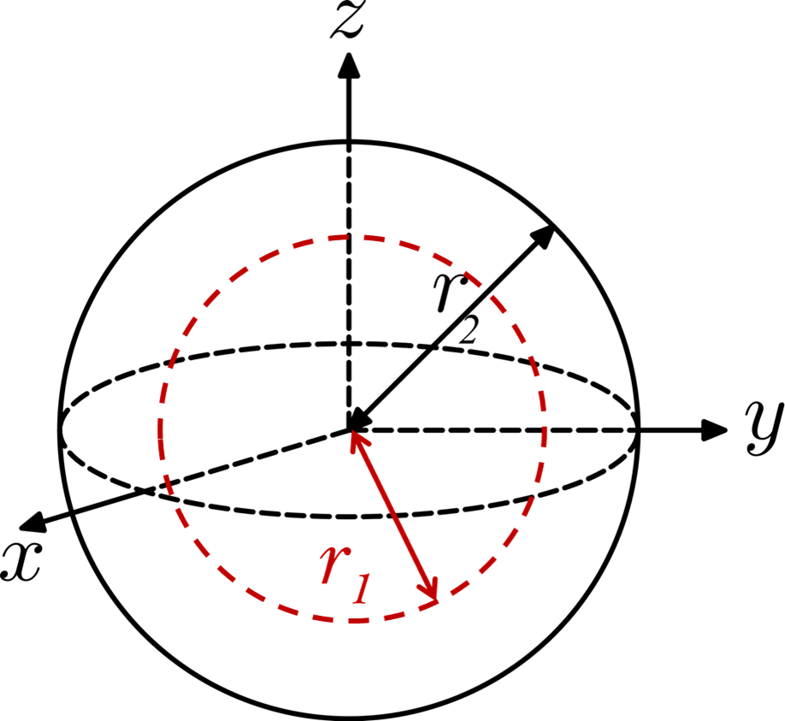
MOMENT OF INERTIA
INTRODUCTION
Definition : If a rigid body rotates around an axis , then moment of inertia of that body with respect to that axis means the summation of the product of square of distance from the axis and mass of each of the particles of that body.

Slide 8
MOMENT OF INERTIA
REAL LIFE USES

Slide 9
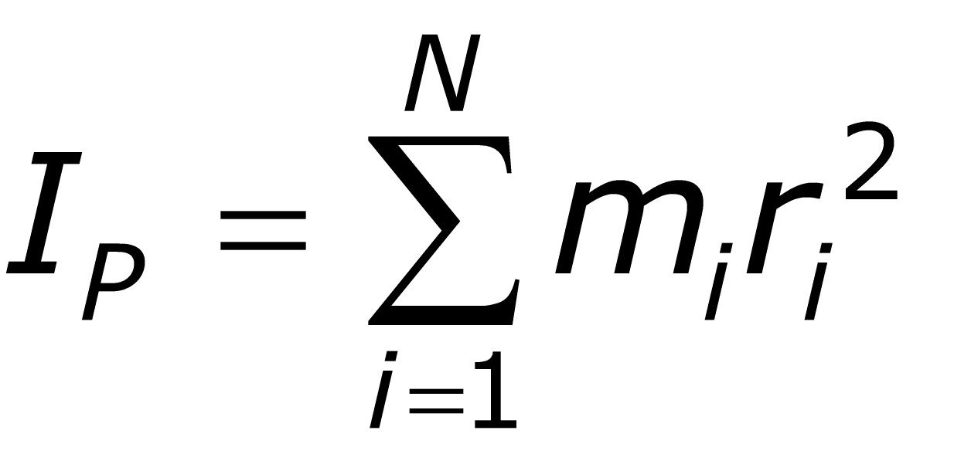
MOMENT OF INERTIA
HISTORY
The term moment of inertia was introduced by Leonhard Euler in his book in 1765, and it is incorporated into Euler’s second law.

Slide 10
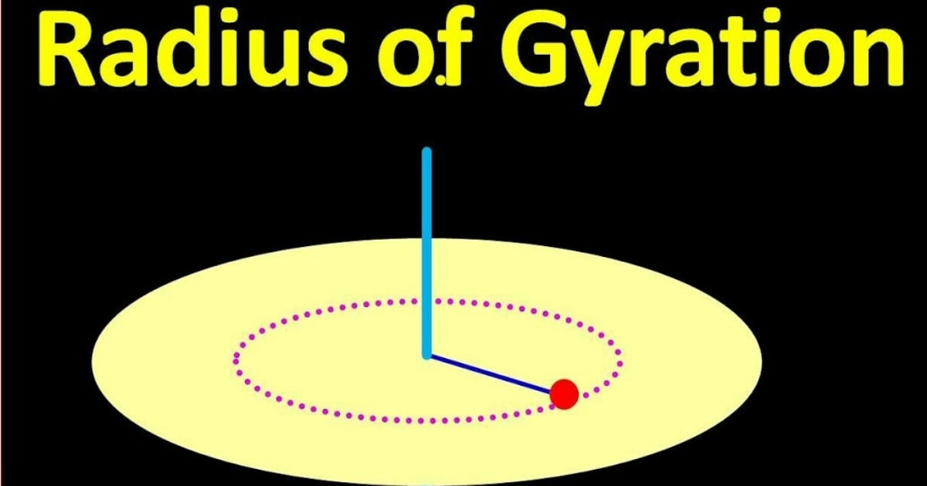
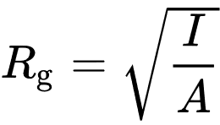
MOMENT OF INERTIA
RADIOUS OF GYRATION
Definition : If the total mass of a rigid body is assumed to be concentrated at a point and if the moment of inertia of that point mass with respect to a rotational axis is equal to the moment of inertia of that whole body , then the distance of that point from the axis is called the radius of gyration . It is denoted by K. In structural engineering, the two-dimensional radius of gyration is used to describe the distribution of cross sectional area in a column around its centroidal axis with the mass of the body.

Slide 11
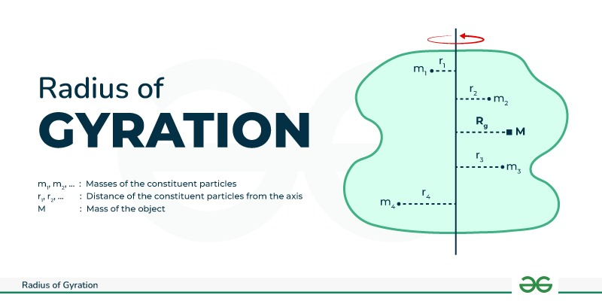
MOMENT OF INERTIA
RADIOUS OF GYRATION
Radius of Gyration FormulaThe radius of gyration can be expressed numerically as the root mean square distance of particles from the axis of rotation. The Formula to calculate the radius of gyration can be derived as follows:The moment of inertia of a body with mass (m) can be given by: I = mk² ….(1)Here, k denotes the radius of gyration.So, the formula for radius of gyration can be given by:K = √I/m ….(2)

Slide 12
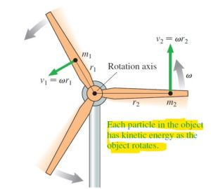

MOMENT OF INERTIA
Rotational Kinetic Energy
Rotational energy or angular kinetic energy is kinetic energy due to the rotation of an object and is part of its total kinetic energy. Looking at rotational energy separately around an object's axis of rotation, the following dependence on the object's moment of inertia is observed:

Slide 13
MOMENT OF INERTIA
Rotational Kinetic Energy
Formula:
Where:
Er is rotational kinetic energy
I is moment of inertia
W is the angular velocity

Slide 14
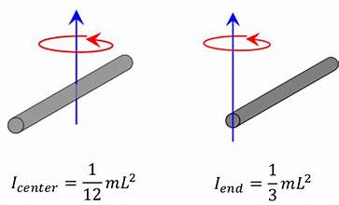
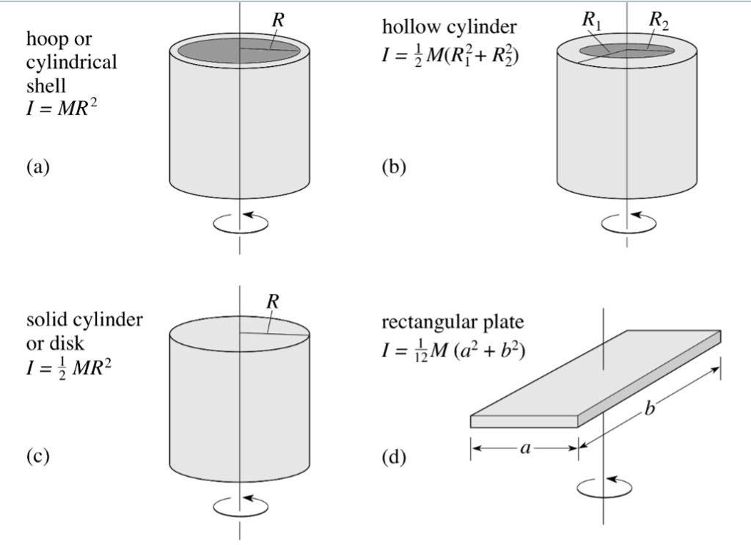
MOMENT OF INERTIA
Spacial Cases

Slide 15
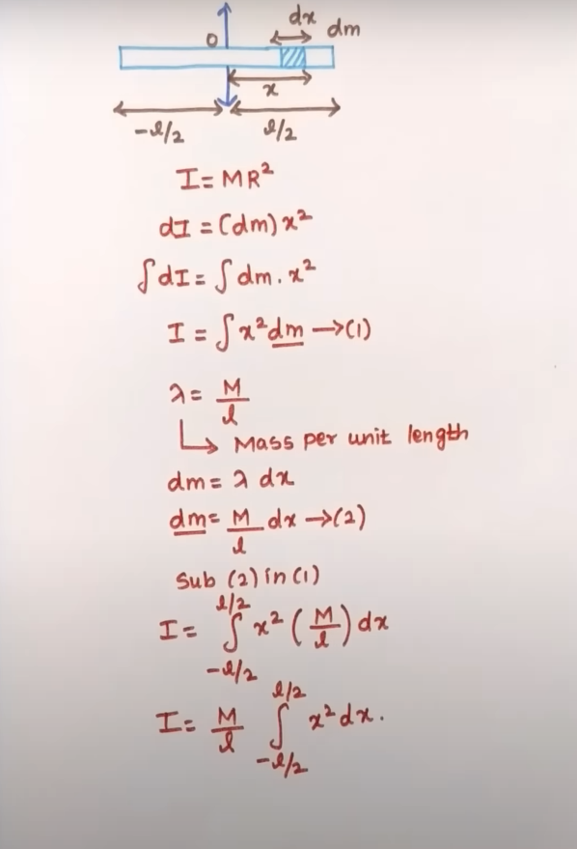
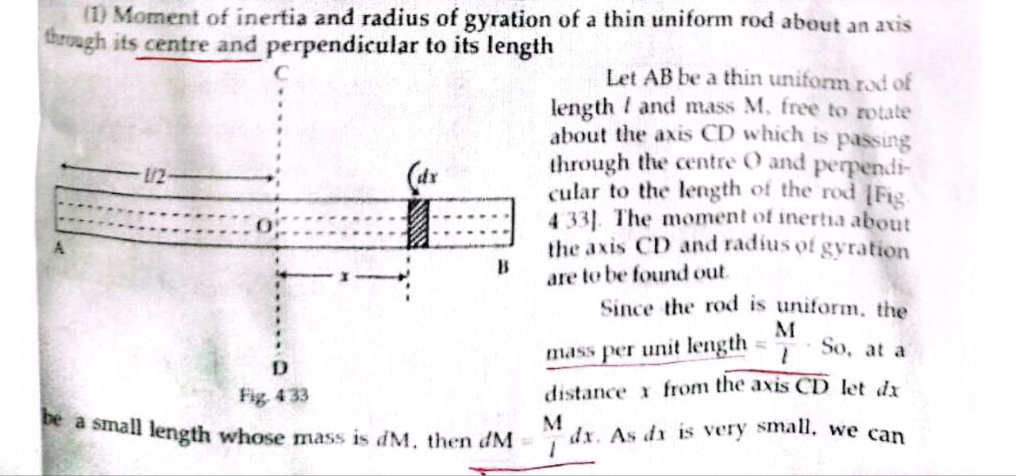
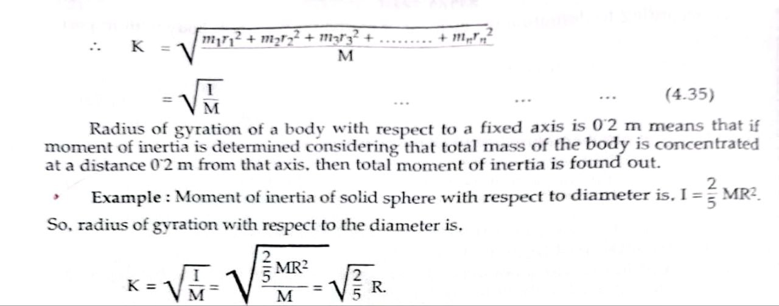
MOMENT OF INERTIA
Spacial Cases

Slide 16
THANK YOU!

